Slide 1
Developing A New Research Proposal
By Govindan Namboothiri S
Department of Physics
AM.PS.R4PHY24004

Slide 2
Content
What is a research proposal?
Basic components
How to pick a research problem?
Defining the problem
Research Design
Different research design
Basic components in detail

Slide 3
What is a research proposal?
A research proposal is a persuasive piece of writing that demonstrates the quality and importance of the project, as well as the ability to conduct the research. The goal is to convince the reader to support the work, whether that’s a supervisor, funding provider, or a journal editor.

Slide 4
Basic Components
Title
Abstract
Introduction
Review of literature
Aim
Objective
Hypothesis
Methodology
Time and Expense
Bibliographic References

Slide 5
How to pick a research problem?
First and foremost, a guide will pick up a research problem for the researcher.
Subject which is overdone should not be normally chosen
Controversial subject should not become the choice of an average researchers.
Too narrow or too vague problems should be avoided.
The subject selected for the research should be familiar and feasible so that the related research material or sources of research within one’s reach.

Slide 6
Defining the problem
Defining a problem involves the task of laying down the boundaries within which a researcher shall study the problem with a pre-determined objective view.
Systematic way of defining the problem
Statement of the problem in a general way
Understanding the nature of the problem
Surveying the available literature
Developing the ideas through discussions
Rephrasing the research problem

Slide 7
Research Design
A research design is the arrangement of conditions for collecting and analysing of data in a manner that aims to combine relevance to the research purpose with economy in procedure.
Based on the design decisions, research design can be split into
The sampling design
The observational design
The statistical design
The operational design

Slide 8
Different Research design
Research design in case of exploratory research studies.
Research design in case of descriptive and diagnostic research studies.
Research design in case of hypotheses-testing research studies

Slide 9
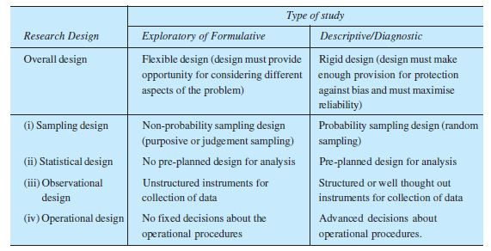
from research methodology methods and techniques C.R Kothari

Slide 10
Title of The Research
It should be concise, descriptive, informative and catchy.
Clearly indicate the independent and dependent variable
It is important to specify what population or universe will be investigated

Slide 11
Abstract
It should be a brief summary .
It should summarize all the important elements of the entire research proposal. Like objectives, methods, time frame etc..

Slide 12
Review of literature
This section includes what is already known about the topic.
No need to include all the previous studies. Only most relevant and important has to keep.
Review of the literature are simply to understand the current phase of topic

Slide 13
Aim
Aim is simply what is our final goal on this particular project
It could be an experimental result, a new mathematical formalism, etc..
An aim is generally broad.

Slide 14
Objectives
The objectives are the specific steps you will take to achieve your aim.
The objective stated should be specific, achievable and measurable
Too many objectives to be avoided
Even just one clearly stated relevant objective for a study would be good enough
If there is more than one objective the objectives can be presented in the appropriate order of importance

Slide 15
Hypotheses
A supposition or proposed explanation made on the basis of limited evidence as a starting point for further investigation.
Any Hypotheses has to be experimentally/observationally proven in order to become a theory or fact.

Slide 16
Methodology
Methodology explains the procedures that will be used to achieve the objectives
Determine which method is used for
Data collection
Data analysis
Interpretation

Slide 17
Time and Expense
The total time you have to spend on the project, including time for project management, preparation of conference papers, writing reports and so..
The expense includes cost of resource, salaries, materials etc..
Contingency budget of 10-20% for unexpected expenses

Slide 18
Bibliographic references
Provide the reader about the source of data
Follow the proper referencing guidelines as directed by the research approval authorities.
Institutional Review Boards (IRBs)
Research Ethics Committees (RECs)
Central Drugs Standard Control Organization (CDSCO)

Slide 19
Thank you

Slide 20
Reference
Research Methodology Methods and Techniques by C.R.Kothari
Google search (ChatGPT, Chatboat..)

